Slide 1

Welcome to the
Academic Onboarding
The session will start shortly…
Questions? Drop them in the chat. We'll have dedicated moderators answering questions.

Slide 2

Cyber Security Session Housekeeping
The use of disrespectful language is prohibited in the questions, this is a supportive, learning environment for all - please engage accordingly. (Fundamental British Values: Mutual Respect and Tolerance)
No question is daft or silly - ask them!
There are Q&A sessions midway and at the end of the session, should you wish to ask any follow-up questions. Moderators are going to be answering questions as the session progresses as well.
If you have any questions outside of this lecture, or that are not answered during this lecture, please do submit these for upcoming Academic Sessions. You can submit these questions here: Questions

Slide 3
Cyber Security Session Housekeeping cont.
For all non-academic questions, please submit a query: www.hyperiondev.com/support
Report a safeguarding incident: www.hyperiondev.com/safeguardreporting
We would love your feedback on lectures: Feedback on Lectures
If you are hearing impaired, please kindly enable captions on Google chrome/Microsoft Edge via the accessibility settings.

Slide 4


Slide 5


CyberSecurity
December 2024
Notes:
Welcome to the Grammar Skills Bootcamp Orientation for November 2023. Today, we will cover several important aspects of this program to ensure you have all the information needed for a successful learning experience.

Slide 6



2. Visual Studio Code
What is VSCode?
Installation
GitHub
Define what GitHub is and what you’ll be using it for?
Describe how to access content and submit tasks.
Objectives
3. Package Managers
Chocolatey (Windows)
Homebrew (MacOS and Linux)
Installing Python

Slide 7

What is GitHub?
https://github.com/
https://docs.github.com/en
Access notes and content
Upload answer files
Notes:
Abstraction - the concept of defining complex functionality using a single term. Good for defining high-level bits of functionality

Slide 8
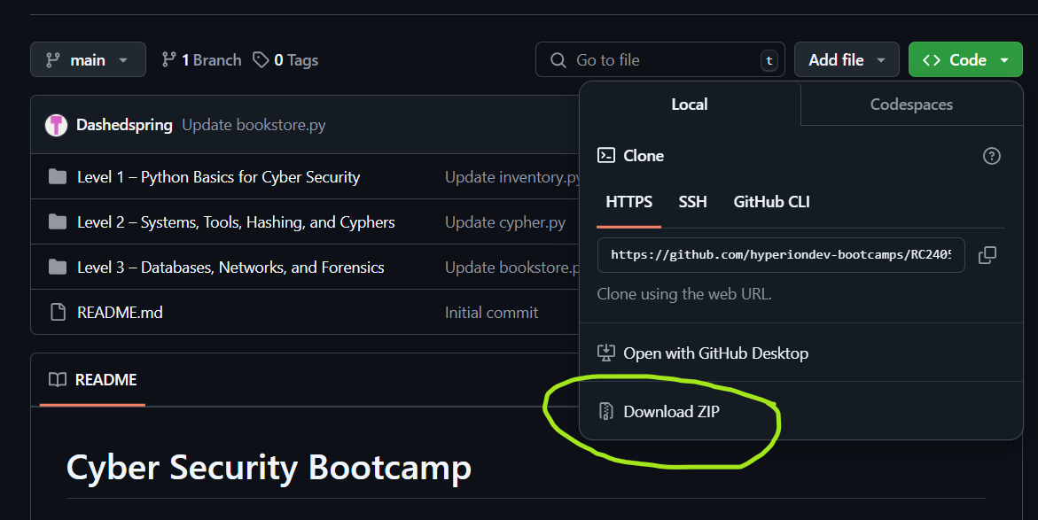
Accessing Your Content
Content is available on GitHub
Download your files
Read
Study
Practice
Notes:
Abstraction - the concept of defining complex functionality using a single term. Good for defining high-level bits of functionality

Slide 9
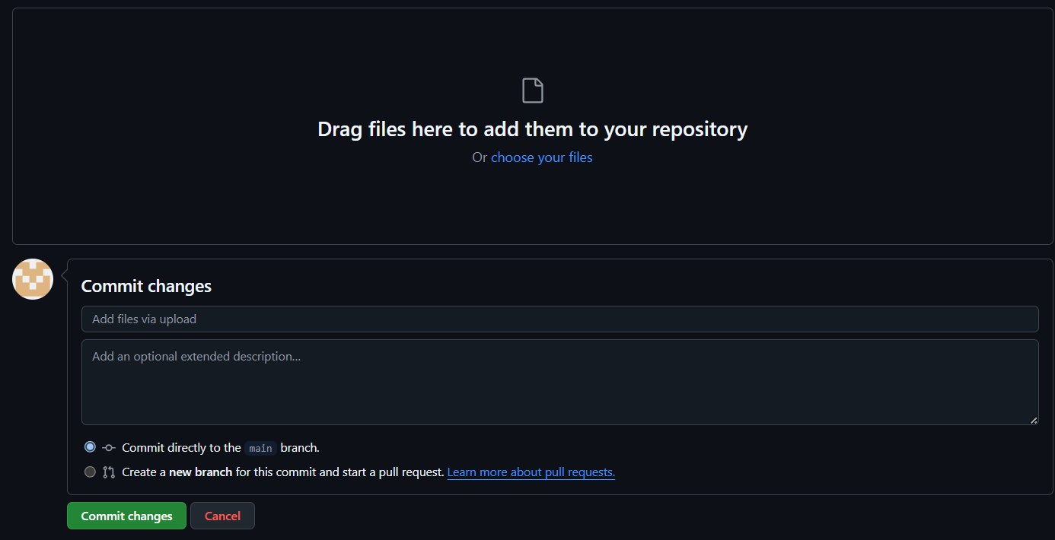
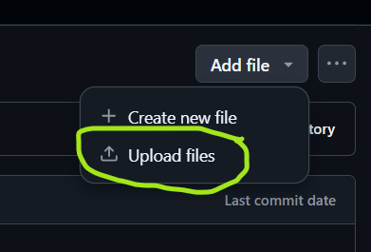
Submitting Your Answers for Review
Navigate to the task
Click on “Add file”
Upload your answer
Notes:
Abstraction - the concept of defining complex functionality using a single term. Good for defining high-level bits of functionality

Slide 10



Preface: Operating Systems
Which operating system do you use?
Notes:
Abstraction - the concept of defining complex functionality using a single term. Good for defining high-level bits of functionality

Slide 11


Visual Studio Code
Notes:
Abstraction - the concept of defining complex functionality using a single term. Good for defining high-level bits of functionality

Slide 12
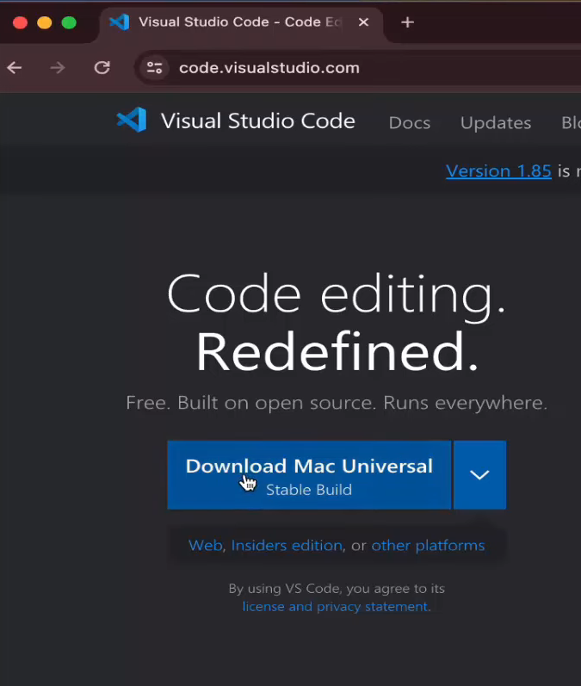
Installing VSCode
https://code.visualstudio.com/
https://code.visualstudio.com/docs
Intro Videos
Setup
User Interface
Notes:
Abstraction - the concept of defining complex functionality using a single term. Good for defining high-level bits of functionality

Slide 13
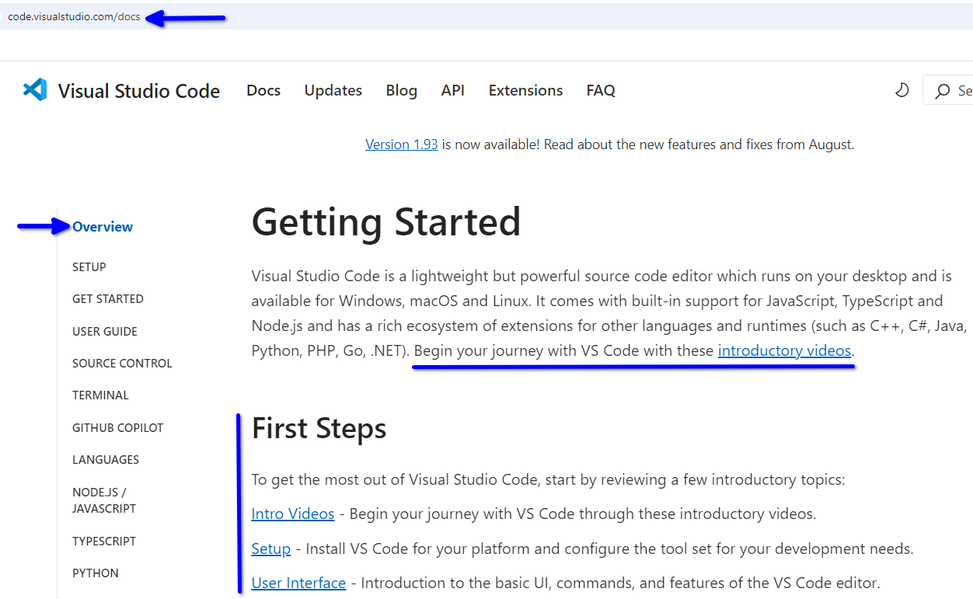

VSCode > Docs
Notes:
Abstraction - the concept of defining complex functionality using a single term. Good for defining high-level bits of functionality

Slide 14
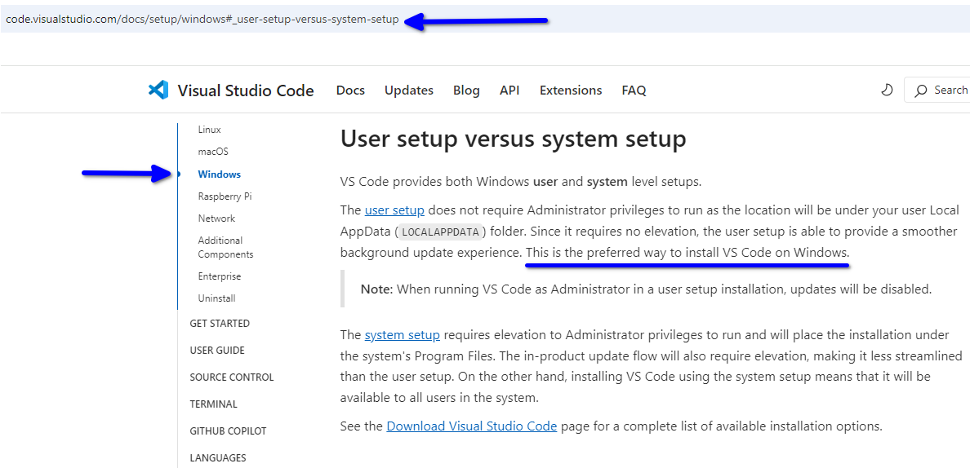
VSCode > Windows
Notes:
Abstraction - the concept of defining complex functionality using a single term. Good for defining high-level bits of functionality

Slide 15
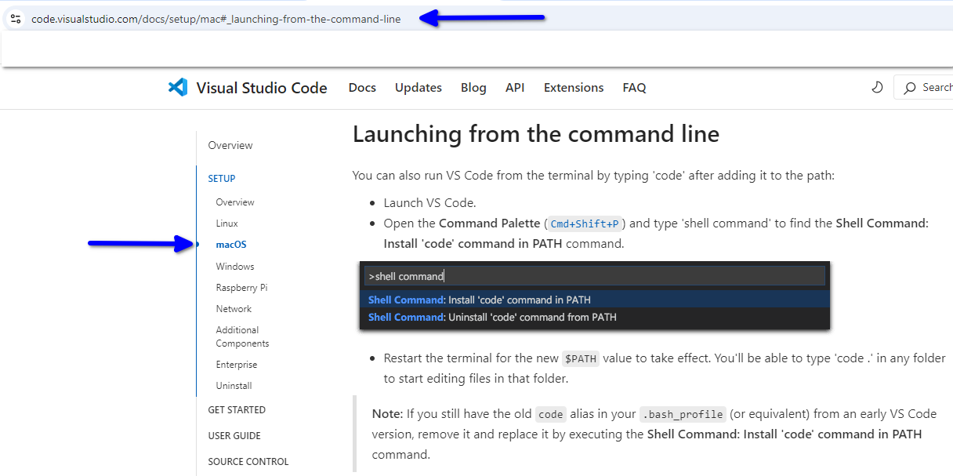
VSCode > MacOS
Notes:
What is a data structure?
A data structure is a particular way of organizing data in a computer so that it can be used effectively.

Slide 16
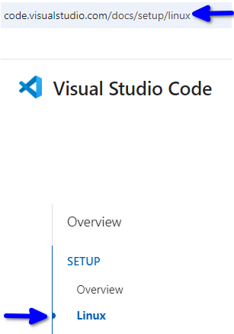
VSCode > Linux
Docs > Setup > Linux
Debian & Ubuntu
RHEL, Fedora & CentOS
openSUSE
Arch
Notes:
Abstraction - the concept of defining complex functionality using a single term. Good for defining high-level bits of functionality

Slide 17

Let's Breathe
Notes:
Abstraction - the concept of defining complex functionality using a single term. Good for defining high-level bits of functionality

Slide 18

Package Managers
Notes:
Abstraction - the concept of defining complex functionality using a single term. Good for defining high-level bits of functionality

Slide 19



Package Managers
Windows ↔ Chocolatey
https://chocolatey.org/install
MacOS (and Linux) ↔ Homebrew
https://brew.sh/
Notes:
Abstraction - the concept of defining complex functionality using a single term. Good for defining high-level bits of functionality

Slide 20


Slide 21
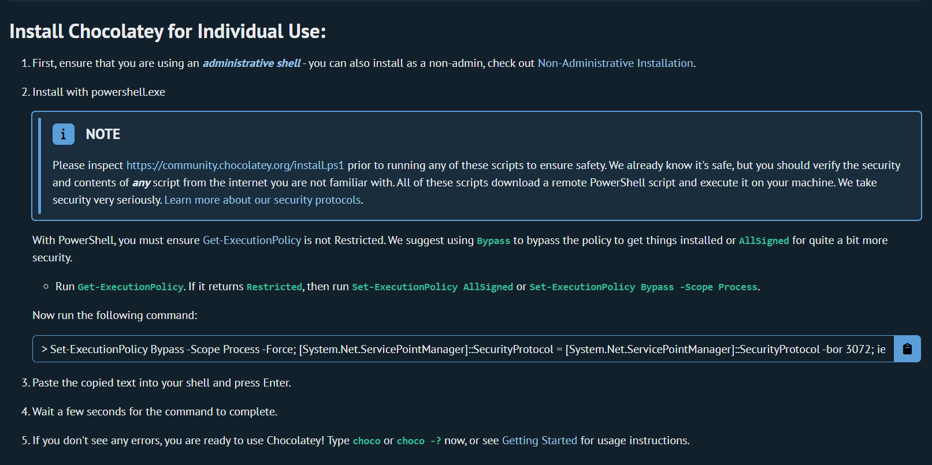

Slide 22
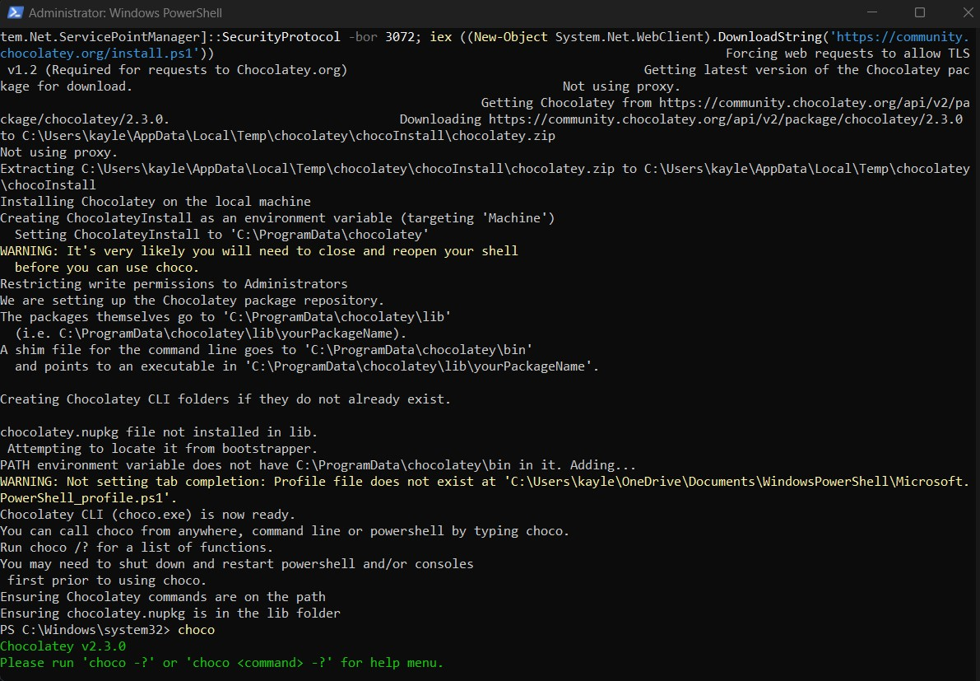
Choco screenshot

Slide 23


Slide 24
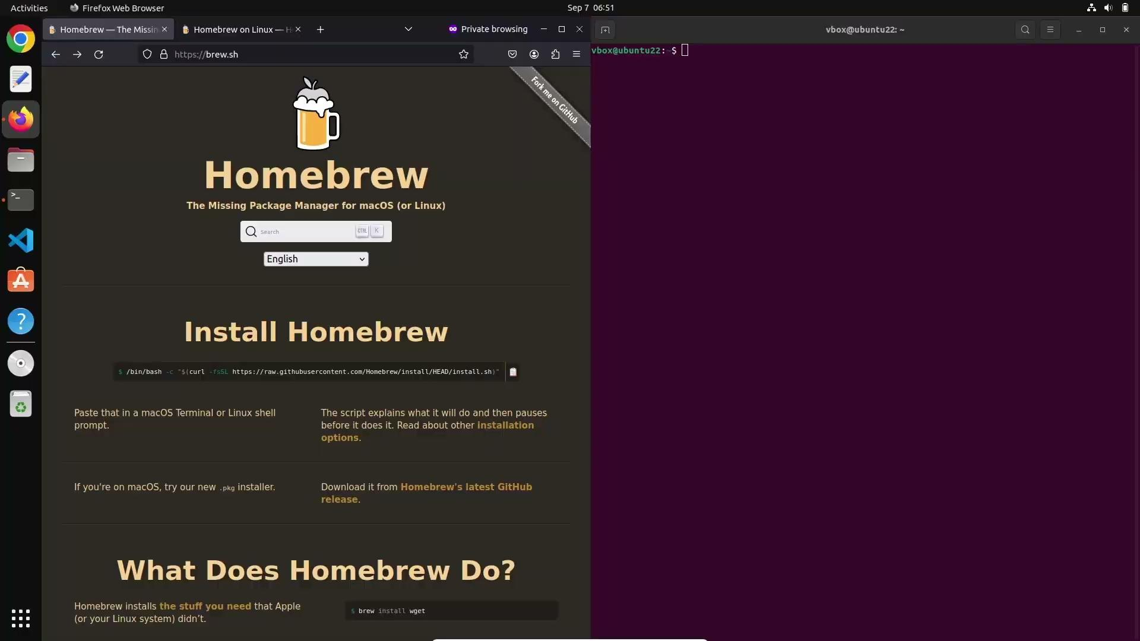
Notes:
Abstraction - the concept of defining complex functionality using a single term. Good for defining high-level bits of functionality

Slide 25

Python 3
Notes:
Abstraction - the concept of defining complex functionality using a single term. Good for defining high-level bits of functionality

Slide 26
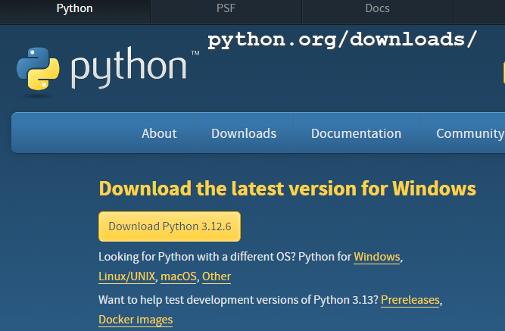
Python 3 > Official Website
Notes:
Abstraction - the concept of defining complex functionality using a single term. Good for defining high-level bits of functionality

Slide 27
Useful Bookmarks
Student Dashboard
GitHub profile
Calendar invites – Lectures
VS Code documentation
Notes:
Abstraction - the concept of defining complex functionality using a single term. Good for defining high-level bits of functionality

Slide 28
Q&A Section
Please use this time to ask any questions relating to the topic explained, should you have any

Slide 29

Thank you for attending

